Slide 1
NETFLIX DATA ANALYSIS
By-
Ahiri Mukherjee
SOURCE OF DATASET :- www.kaggle.com

Slide 2
Problem Statements
Type wise viewership Score
Rank per type of shows
Percentage of Movies/TV Shows in Netflix Exclusive
Type wise number of Movies/TV Shows
Top 5 Movies/TV Shows with highest Viewership Score
Movies/TV Shows that stayed for the maximum time in Top 10
Last Week Rank per show type
Month wise Movie Release
Year wise Movie Release
Date wise Year to date
Rank per Year

Slide 3
Type wise Viewership Score
Row Labels | Count of Viewership Score
Concert/Perfâ€¦ | 2
Movie | 2611
Stand-Up Comedy | 41
TV Show | 4446
Grand Total | 7100

Slide 4
Rank per Type of Movies/ TV Show
Row Labels | Count of Rank
Concert/Perfâ€¦ | 2
Movie | 2611
Stand-Up Comedy | 41
TV Show | 4446
Grand Total | 7100

Slide 5
Percentage of Movies/TV Shows in Netflix Exclusive
Row Labels | Count of Title
Yes | 4599
(blank) | 2501
Grand Total | 7100

Slide 6
Type wise number of Movies/TV Shows
Row Labels | Count of Title
Concert/Perfâ€¦ | 2
Movie | 2611
Stand-Up Comedy | 41
TV Show | 4446
Grand Total | 7100

Slide 7
Top 5 Movies/TV Shows with highest Viewership Score
Movies/TV Shows | Viewership Score
8 | 136
10 | 130
20 | 124
4 | 119
5 | 108

Slide 8
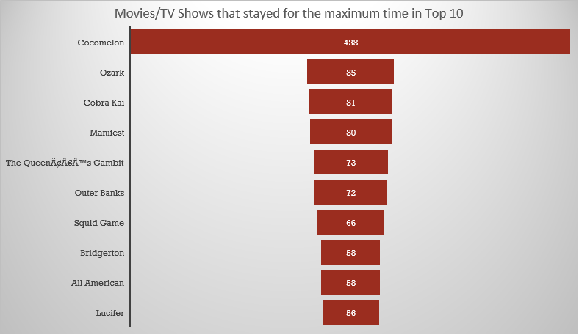
Movies/TV Shows that stayed for the maximum time in Top 10
Movies/TV Shows | Days in Top 10
Cocomelon | 428
Ozark | 85
Cobra Kai | 81
Manifest | 80
The QueenÃ¢Â€Â™s Gambit | 73
Outer Banks | 72
Squid Game | 66
Bridgerton | 58
All American | 58
Lucifer | 56

Slide 9
Last Week Rank per show type
Row Labels | Count of Last Week Rank
Concert/Perfâ€¦ | 2
Movie | 2611
Stand-Up Comedy | 41
TV Show | 4446
Grand Total | 7100

Slide 10
Month wise Movie Releases
Row Labels | Count of Title
Jun | 876
Dec | 665
Apr | 622
Jul | 611
Sep | 584
May | 570
Jan | 570
Oct | 567
Feb | 531
Aug | 520
Mar | 494
Nov | 490
Grand Total | 7100

Slide 11
Year wise Movie Releases
Row Labels | Count of Title
2007 | 1
2013 | 7
2014 | 67
2015 | 96
2016 | 120
2017 | 280
2018 | 353
2019 | 417
2020 | 2881
2021 | 2538
2022 | 340
Grand Total | 7100

Slide 12
Date wise Year to date Rank
Row Labels | Year to Date Rank
2020 | 2750
2021 | 3650
2022 | 700
Grand Total | 7100

Slide 13
Rank Per Year
Row Labels | Rank
2007 | 1
2013 | 7
2014 | 67
2015 | 96
2016 | 120
2017 | 280
2018 | 353
2019 | 417
2020 | 2881
2021 | 2538
2022 | 340
Grand Total | 7100

Slide 14
CONCLUSION:
Analysing the Netflix raw dataset, we can find out various information.
Among the type of shows TV Show is the most common in netfix.
TV Show has the highest count of Rank.
65% of the shows are present in Netflix Exclusive.
Cocomelon is the movie that stayed for the highest time in Top 10.
June is the month with maximum number of movie releases and November is the minimum.
2020 is the year with maximum number of movie releases and 2007 is the minimum.

Slide 15
THANK YOU

Slide 16
This project is explained
further HERE:-
https://drive.google.com/file/d/1HiOzoQxZUZnXWY-mgYsQ7do315fELvc6/view?usp=sharing

